Slide 1
Principles of Big Data Management Project 3
Saketh Garuda (sg7kf)
Sarat Mudunuri (smyx4)
Sreelakshmi Nandanamudi (syb7c)
Sowmya Yalamanchili (snhnc)

Slide 2
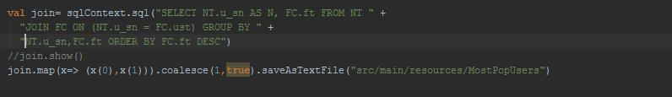
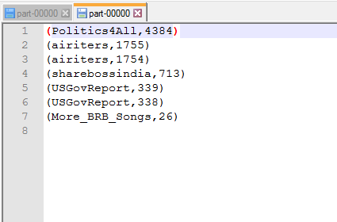
Most Popular Users

Slide 3
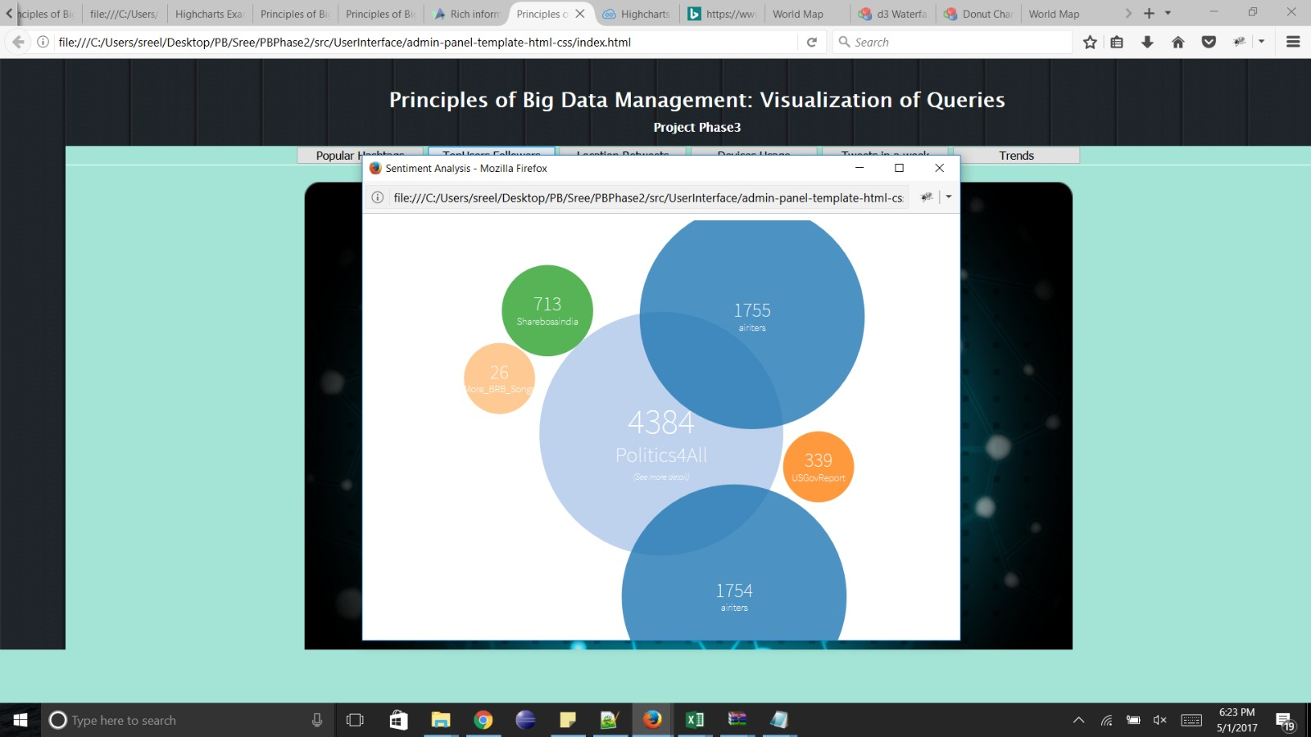

Slide 4
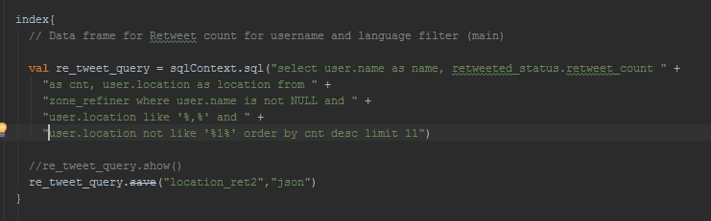
Analyzing Retweet count based on the Location of the User

Slide 5
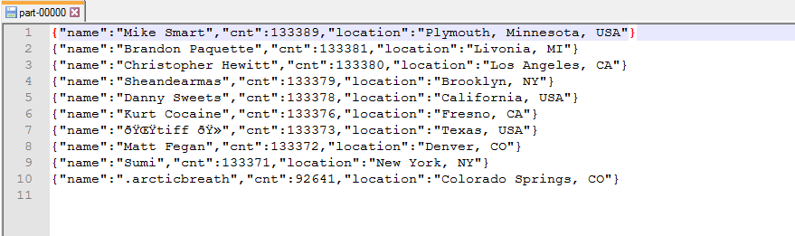

Slide 6
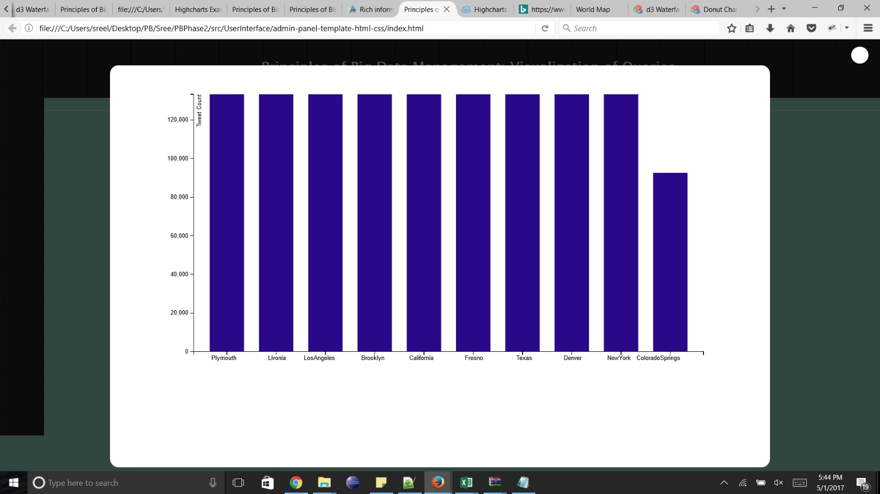

Slide 7
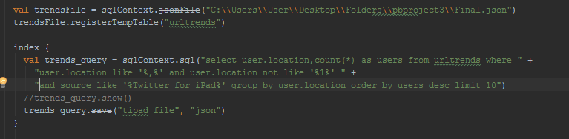
Analyzing location specific device usage

Slide 8
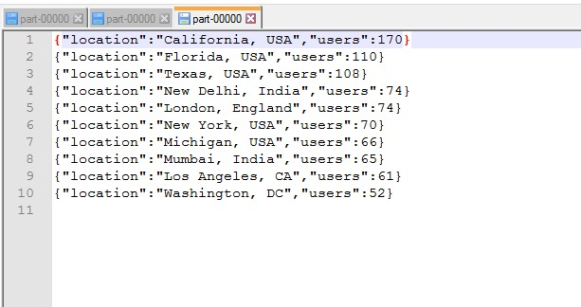
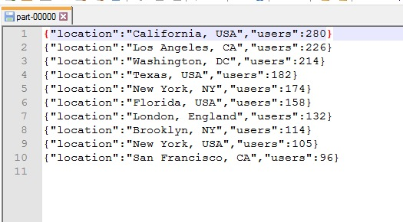

Slide 9
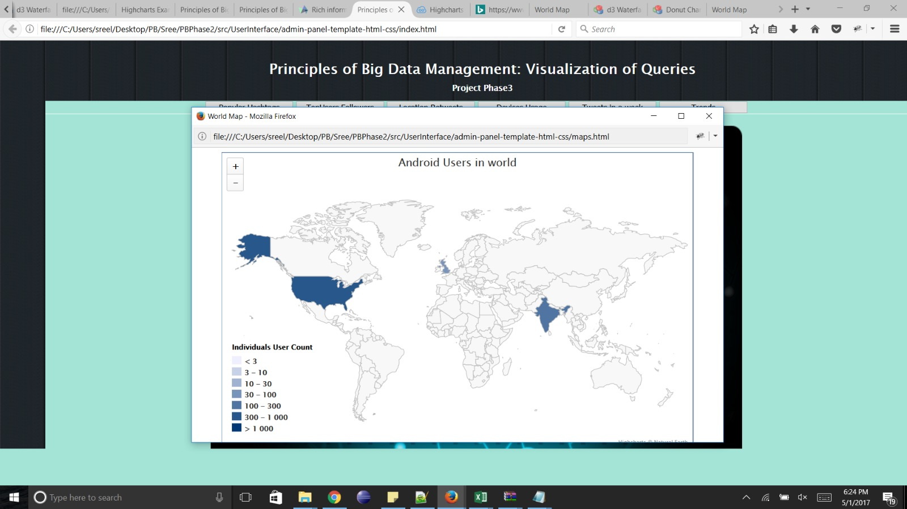

Slide 10
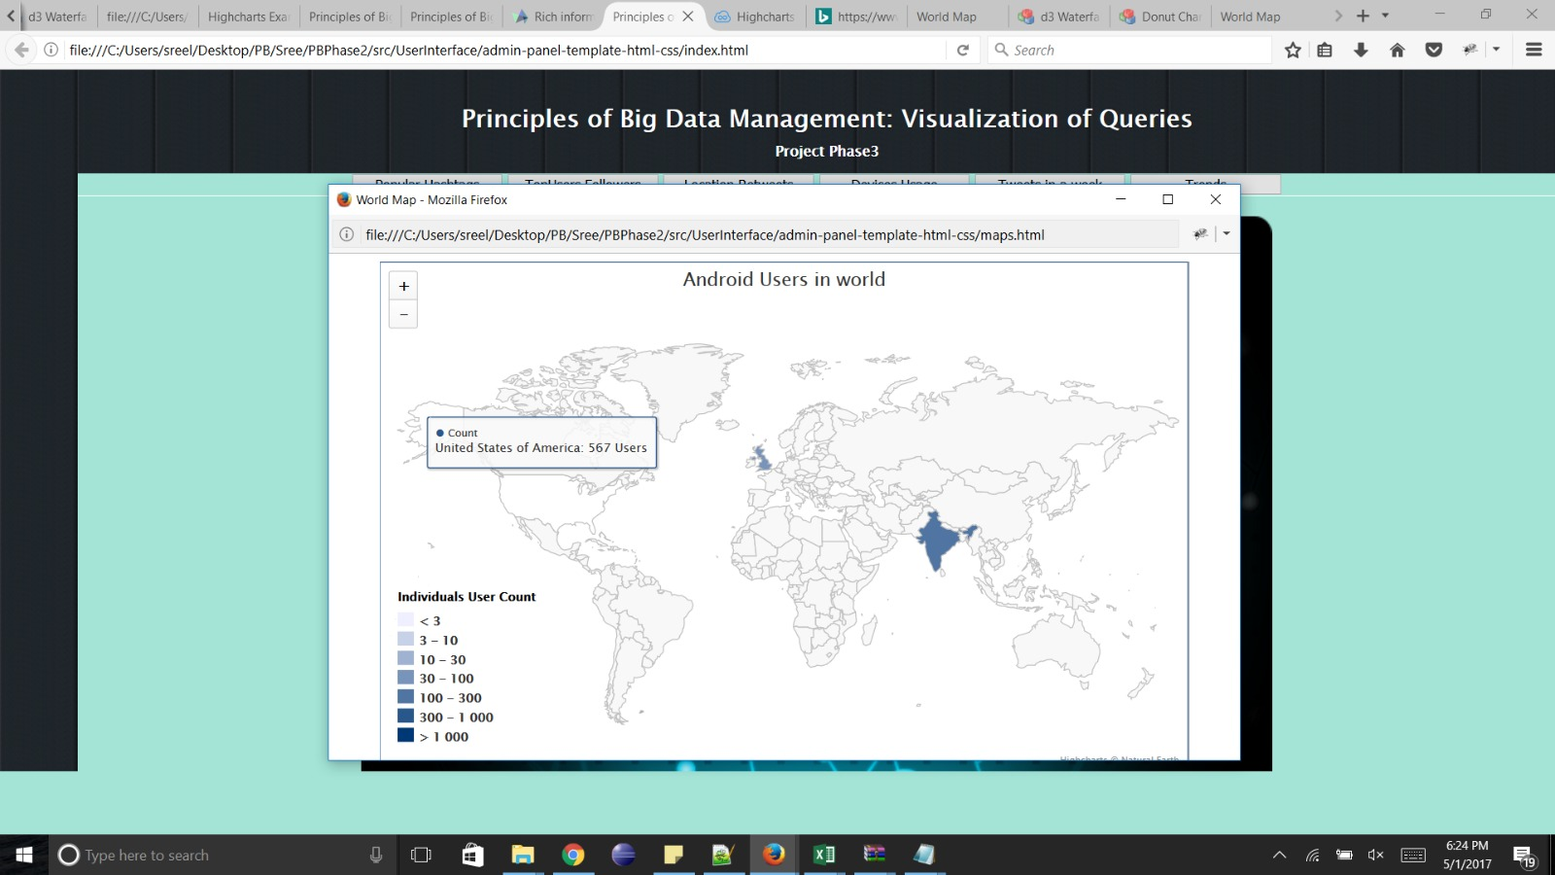

Slide 11


Slide 12

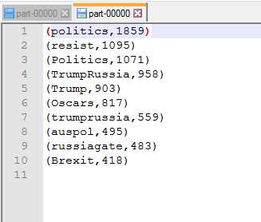
Most Popular Hashtags

Slide 13
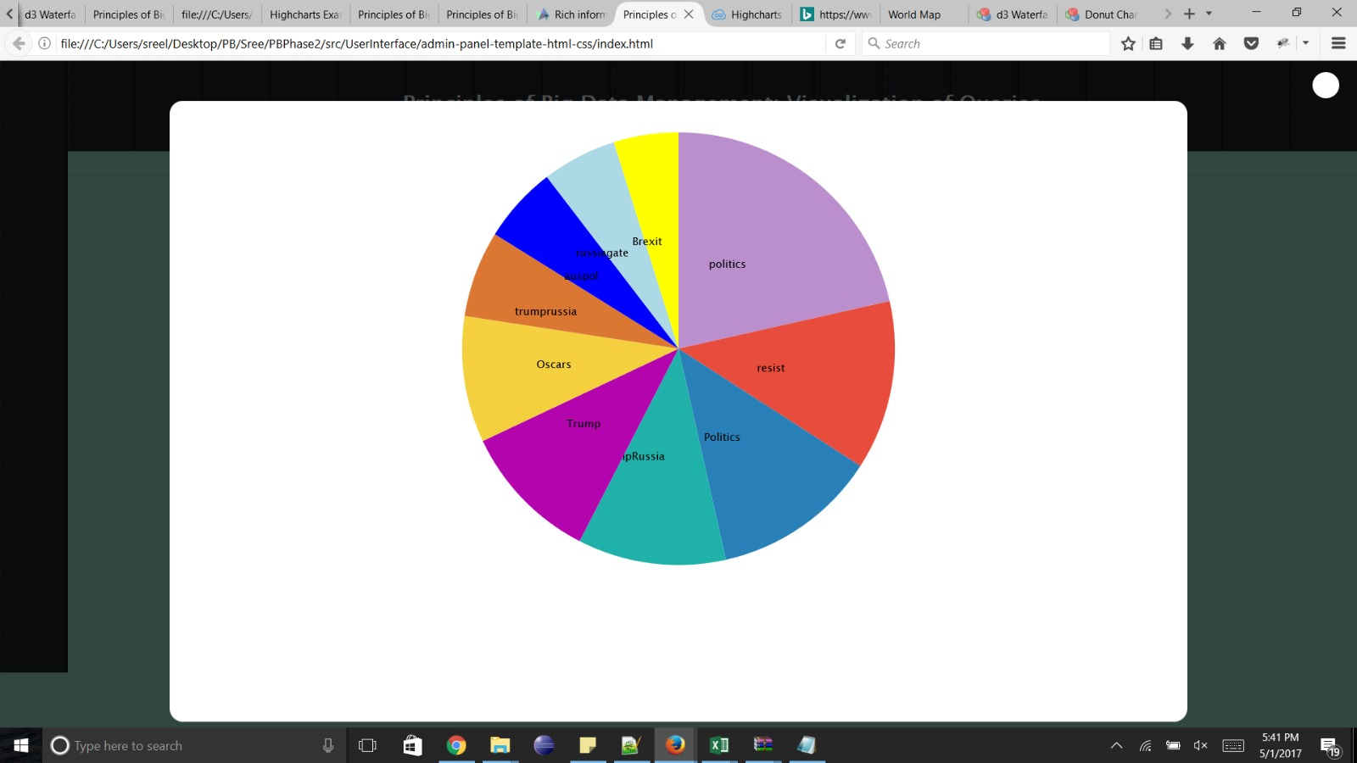

Slide 14
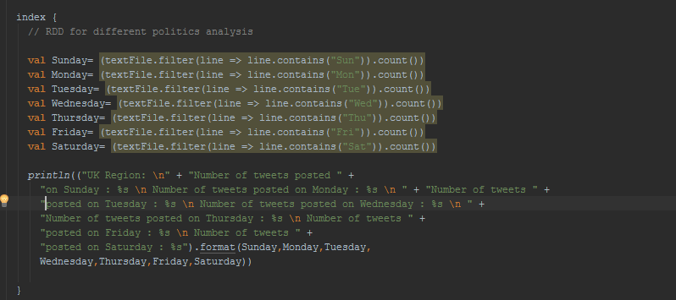
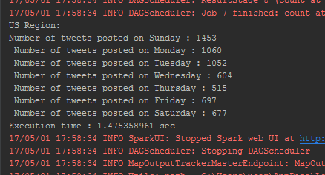
Analyzing number of tweets posted on particular day based on region

Slide 16
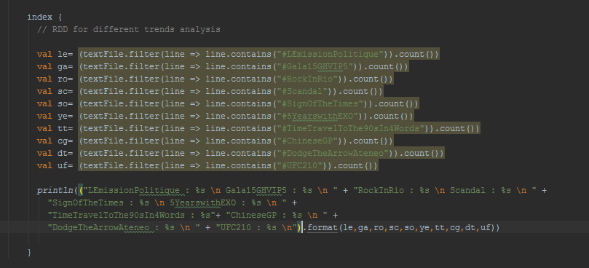
Analyzing hashtags from the given Trends file

Slide 17
